Slide 1
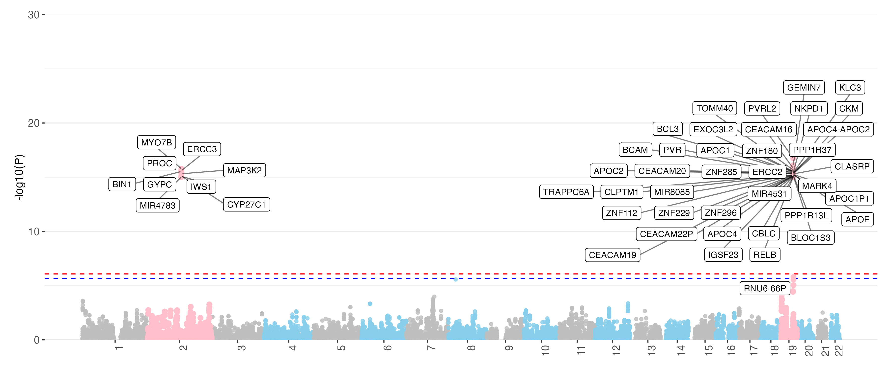
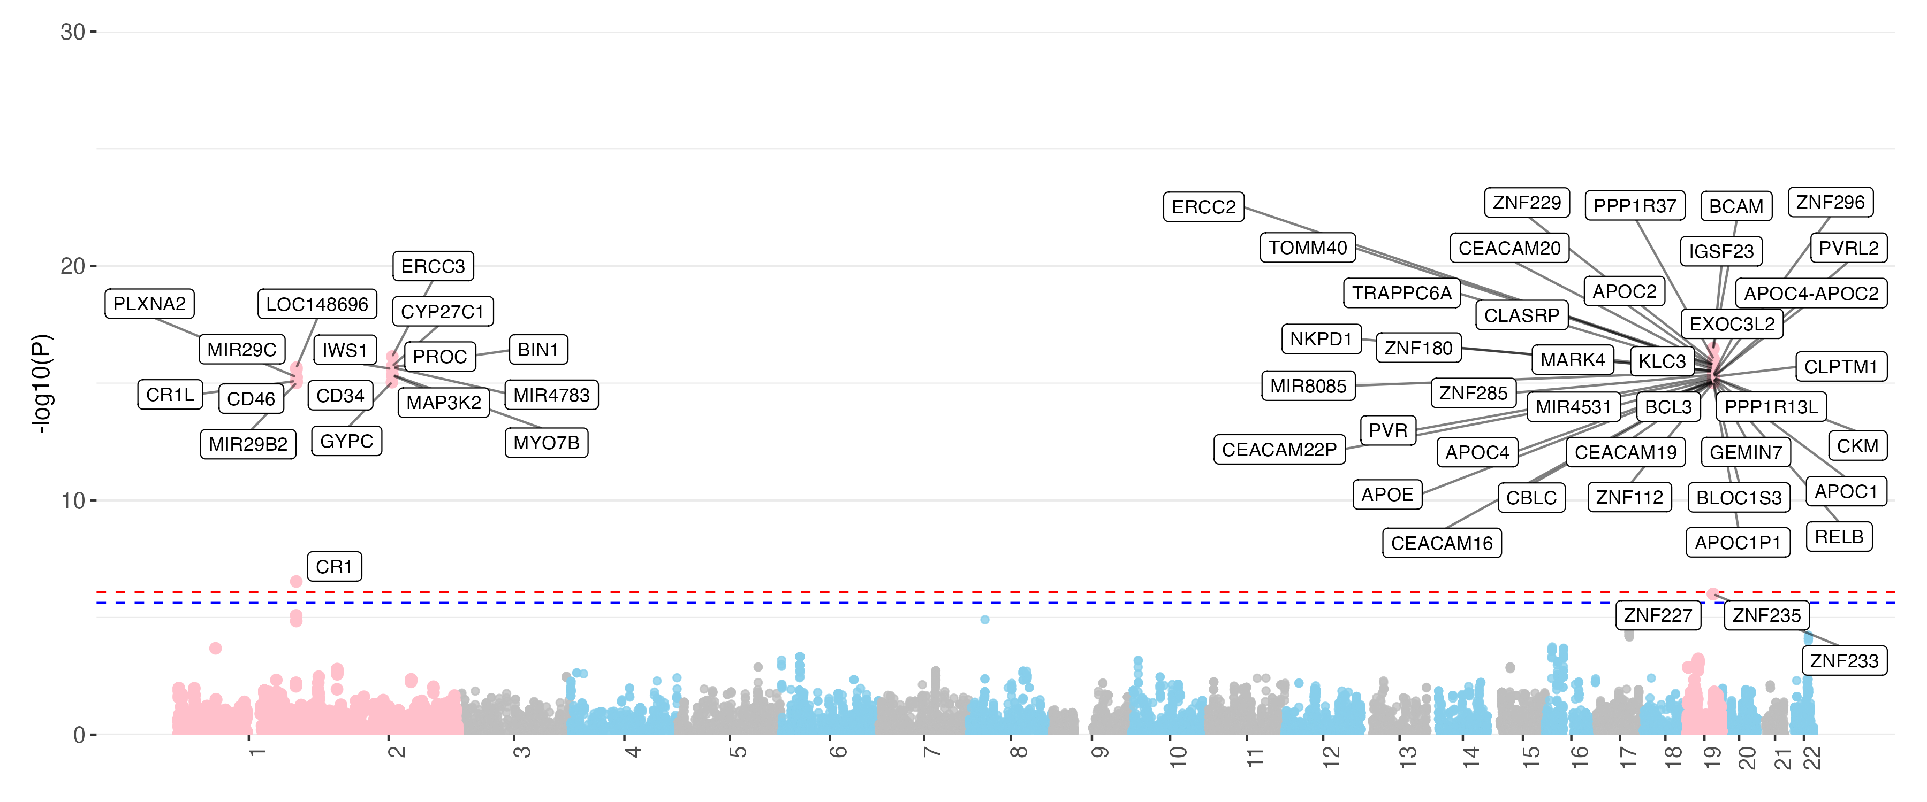
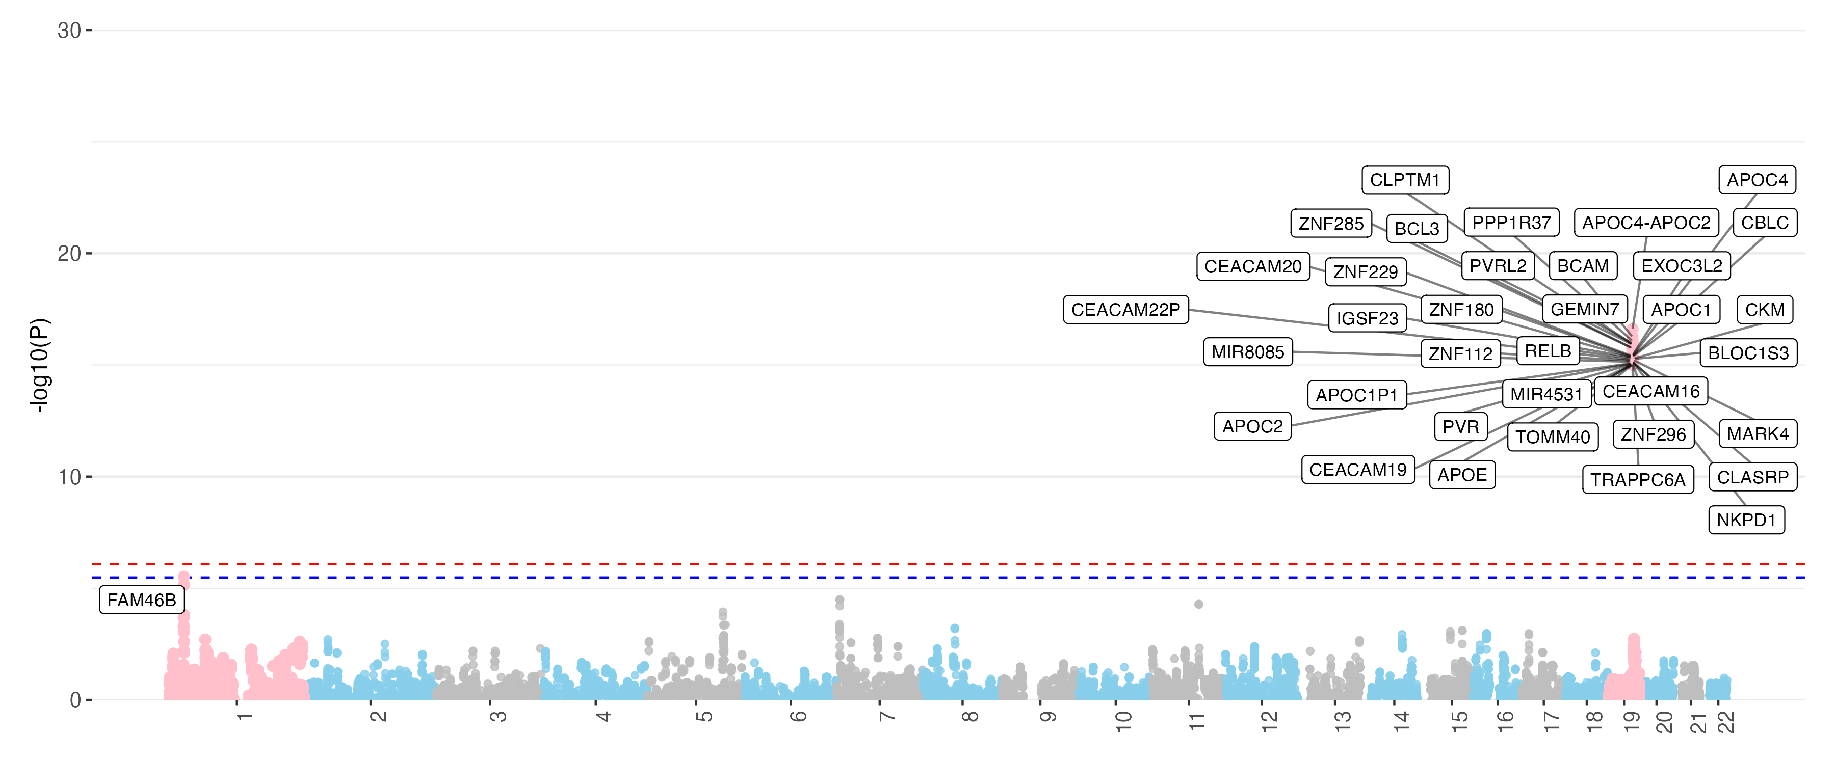
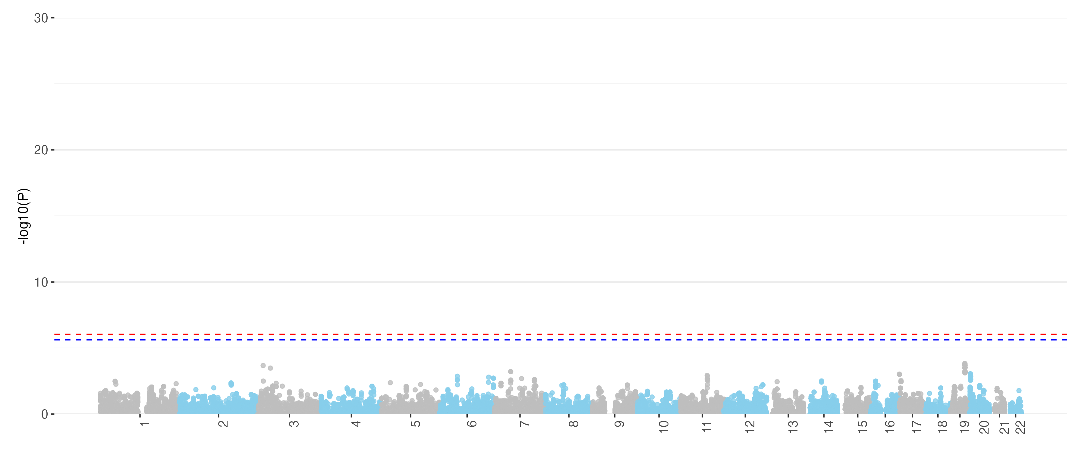
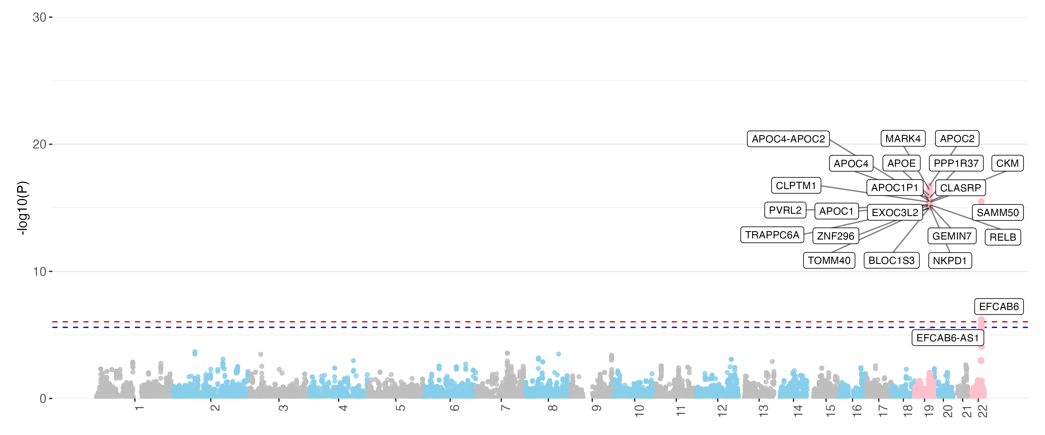
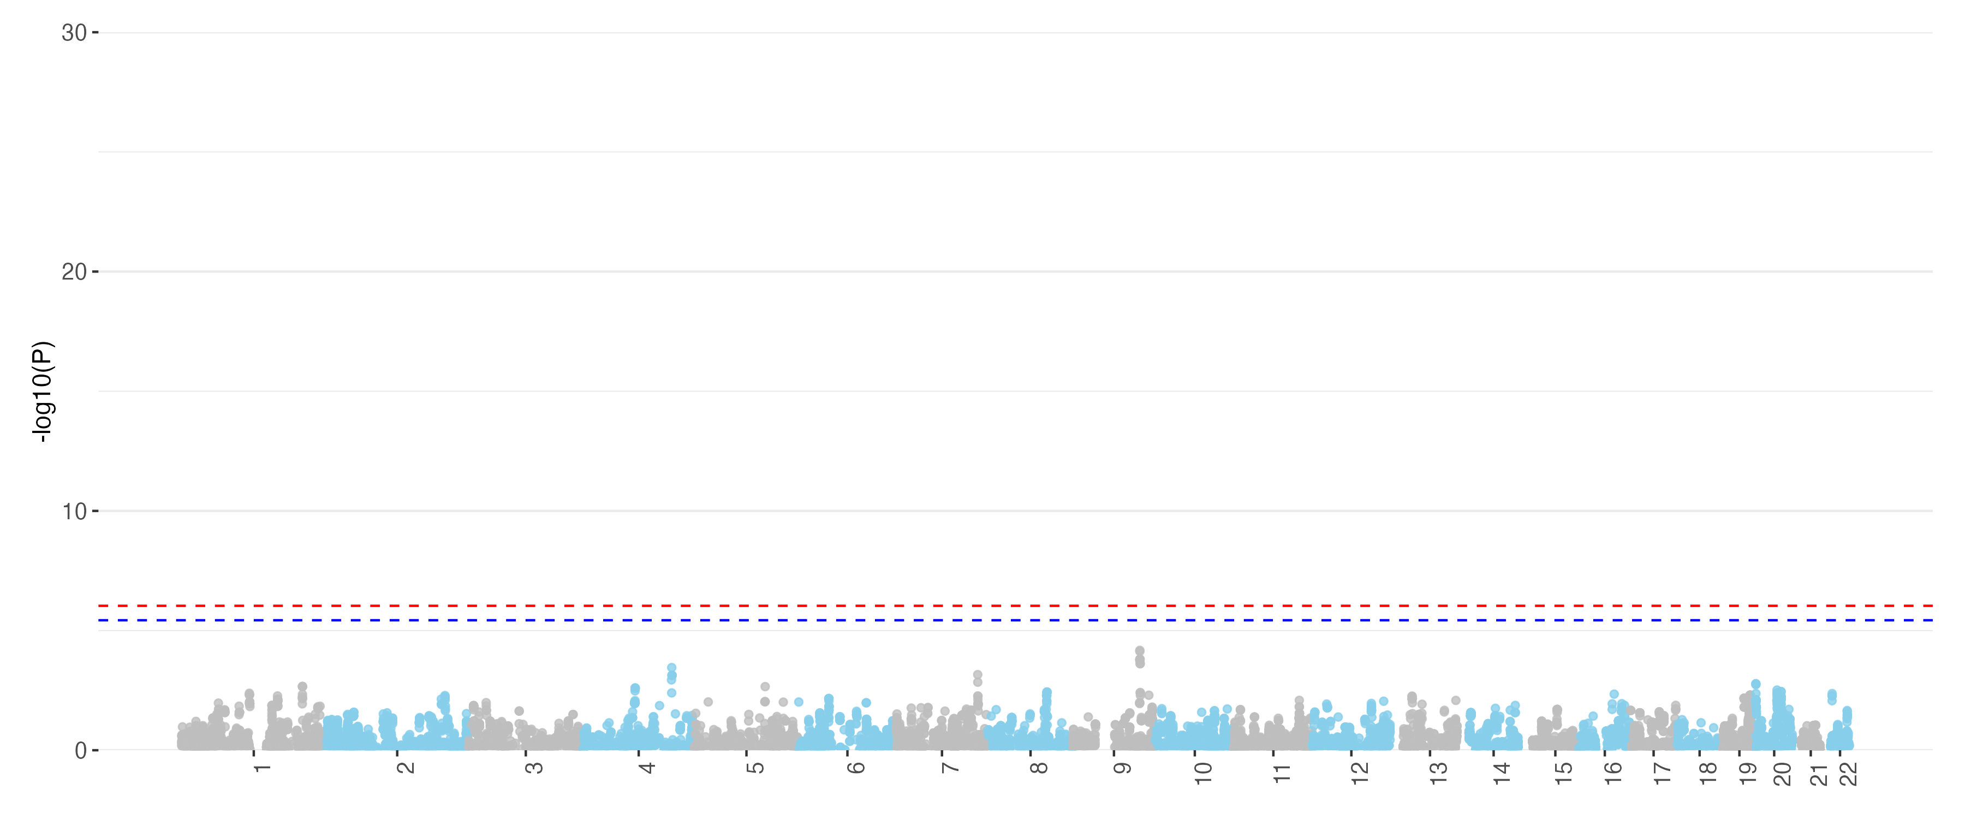
A. IGAP Structural MRI
B. IGAP Diffusion MRI
C. IGAP Functional MRI
D. UKB Structural MRI
E. UKB Diffusion MRI
F. UKB Functional MRI
Notes:
IGAP UKB VC

